Slide 1
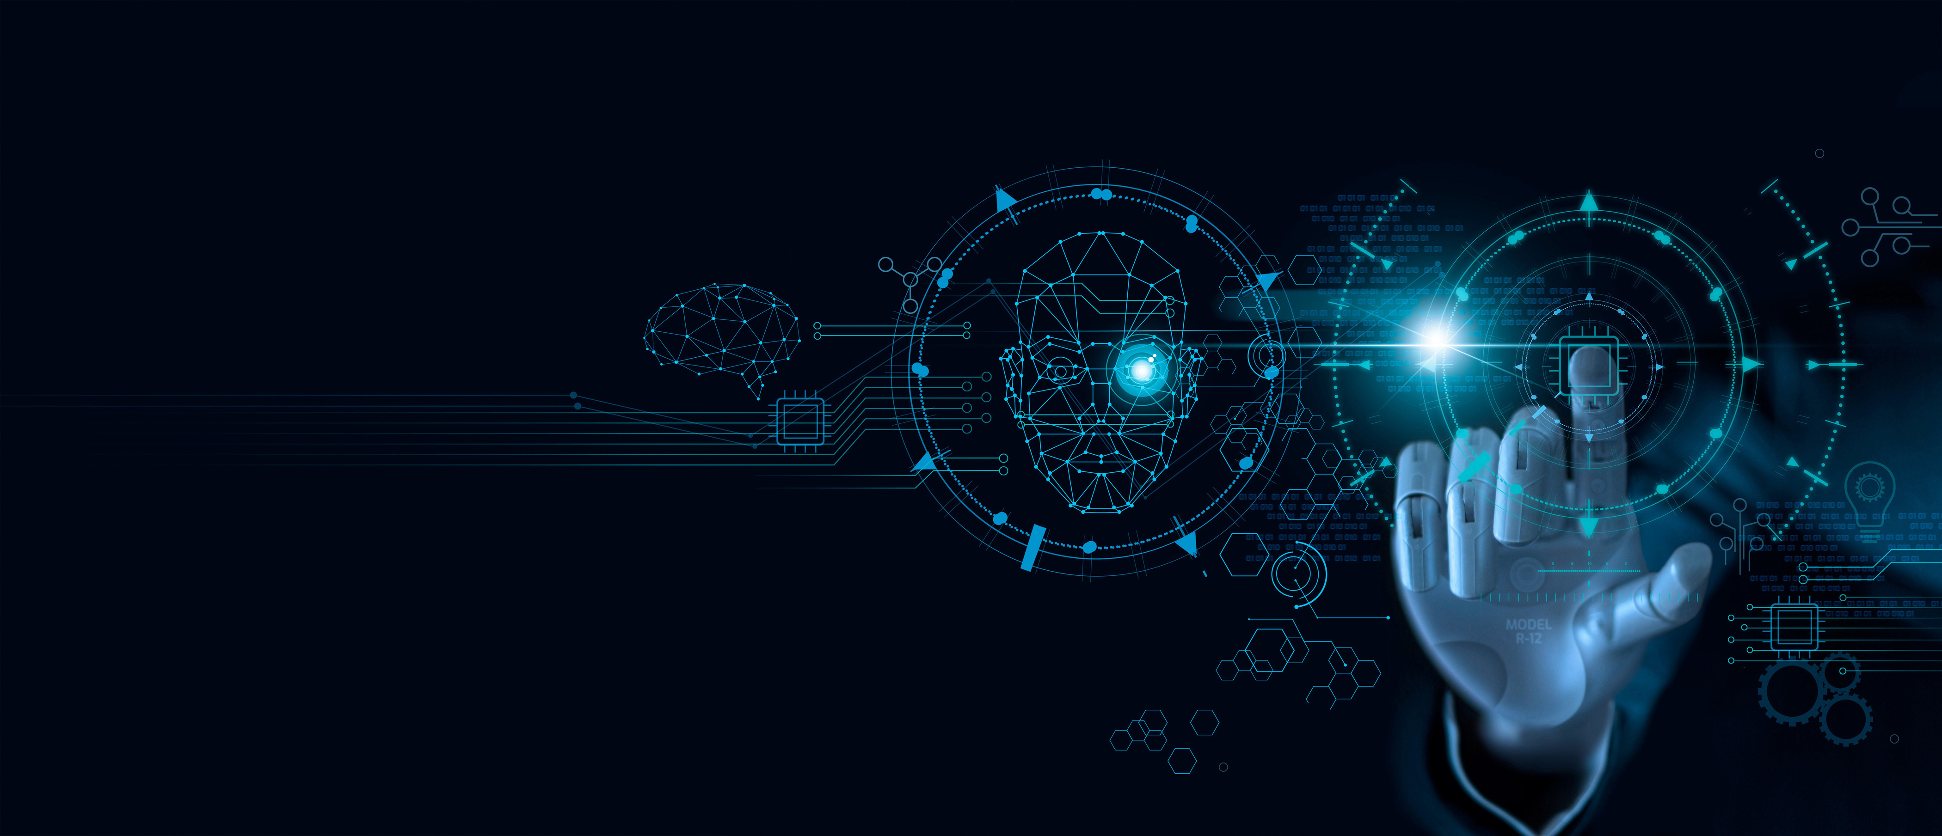

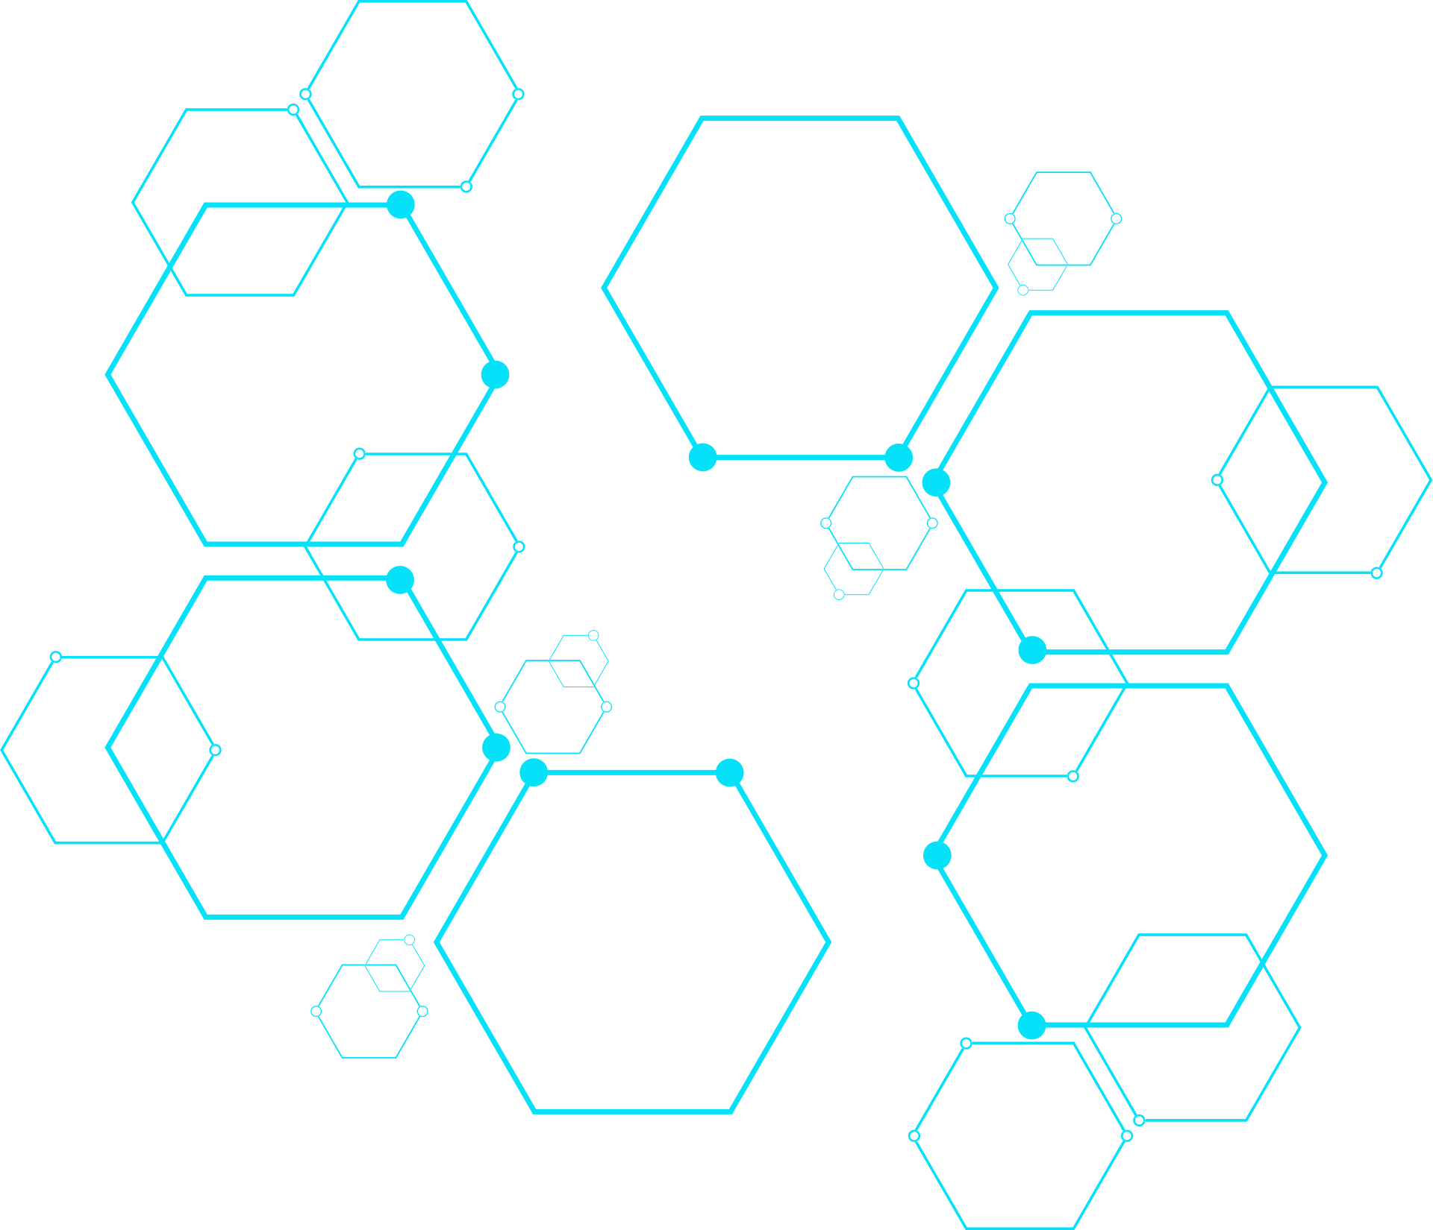
AI Agents
Shaping the Future of Intelligent Automation
www.galtechlearning.com

Slide 2

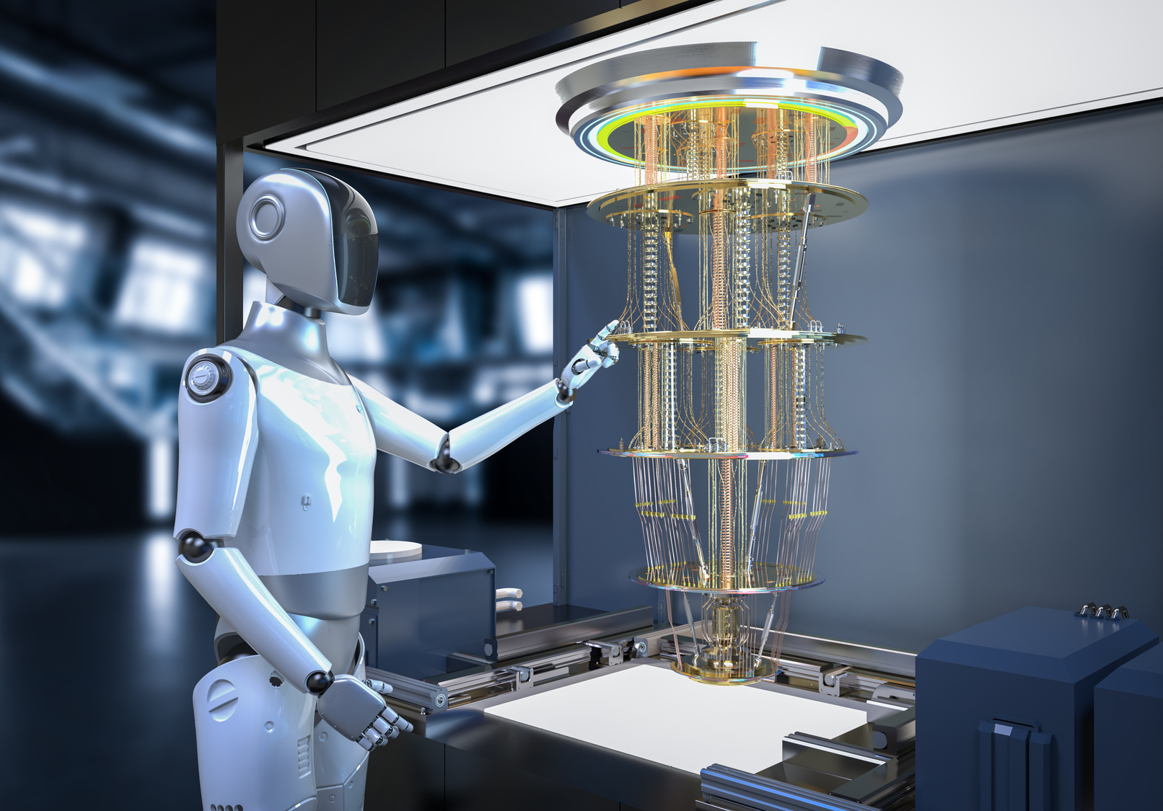


Agenda
Introduction to AI Agents
Real-time Applications

Slide 3
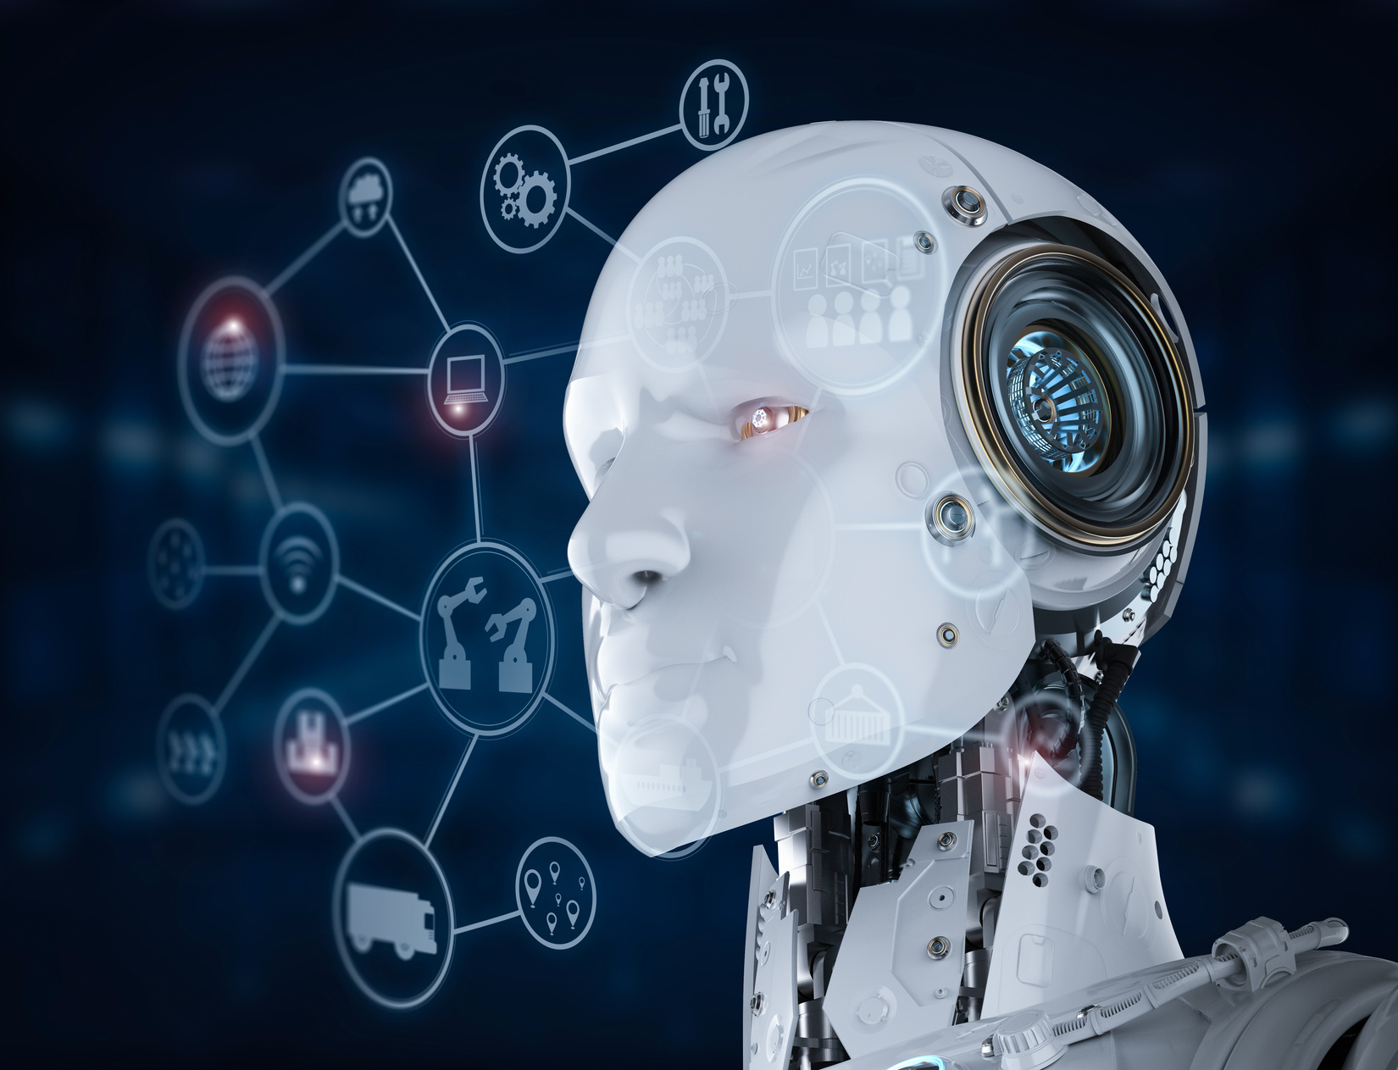
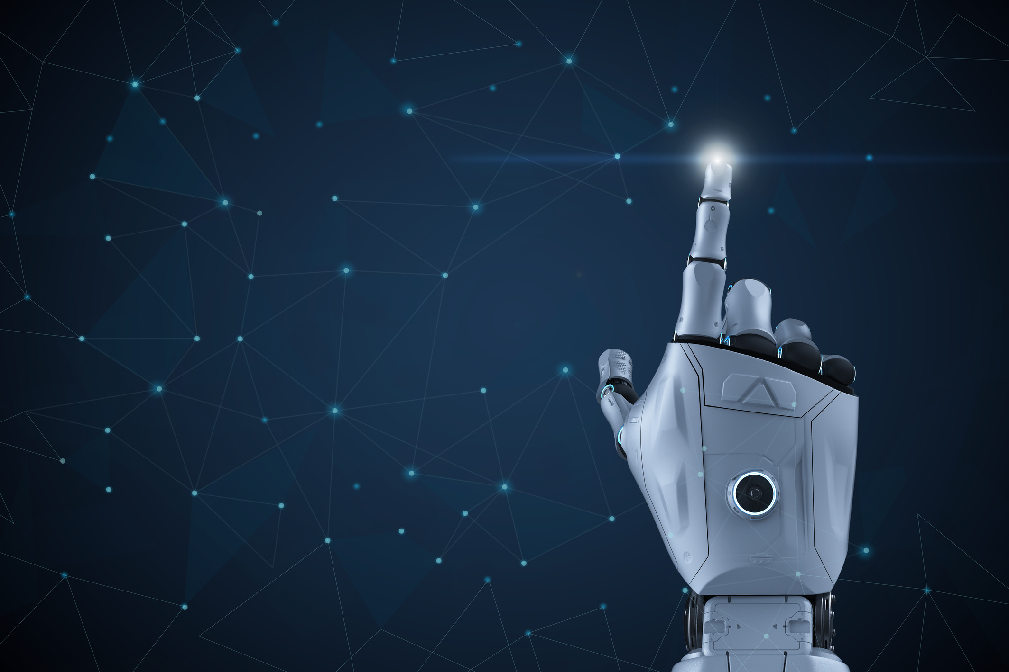
What are AI Agents?
AI agents are systems that perceive their environment, reason about it, and take action to achieve specific goals, often utilising artificial intelligence techniques such as machine learning, natural language processing, or planning algorithms.

Slide 4
What are AI Agents?
An AI agent is a system that can:
Observe — gather data from its environment (e.g., sensors, APIs, text input).
Think — process information and decide what to do (using logic, rules, or learned models).
Act — perform actions (e.g., send messages, move a robot arm, make API calls).

Slide 5
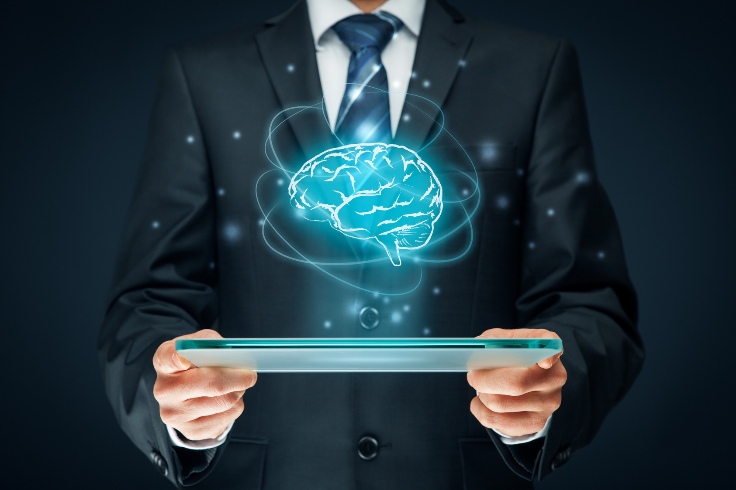
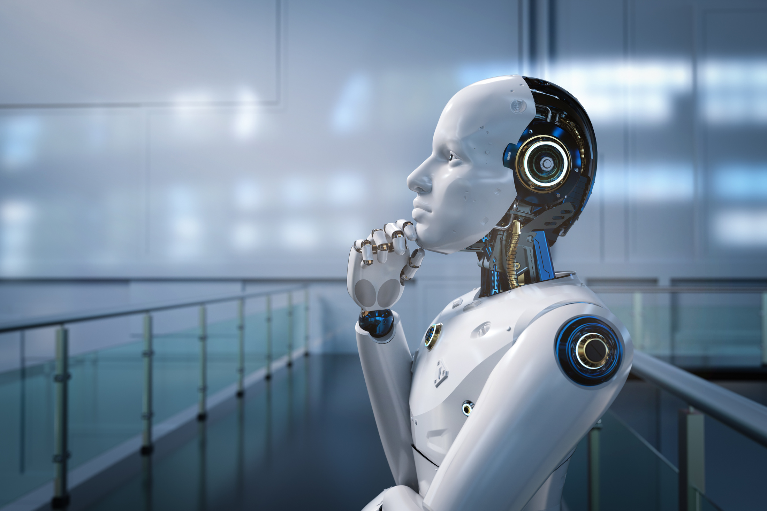
Real-World Applications
AI Agents are transforming various sectors, including healthcare, finance, and customer service.
Tesla-Autopilot
Siri, Alexa
Vaccum Cleaner (Roomba)

Slide 6
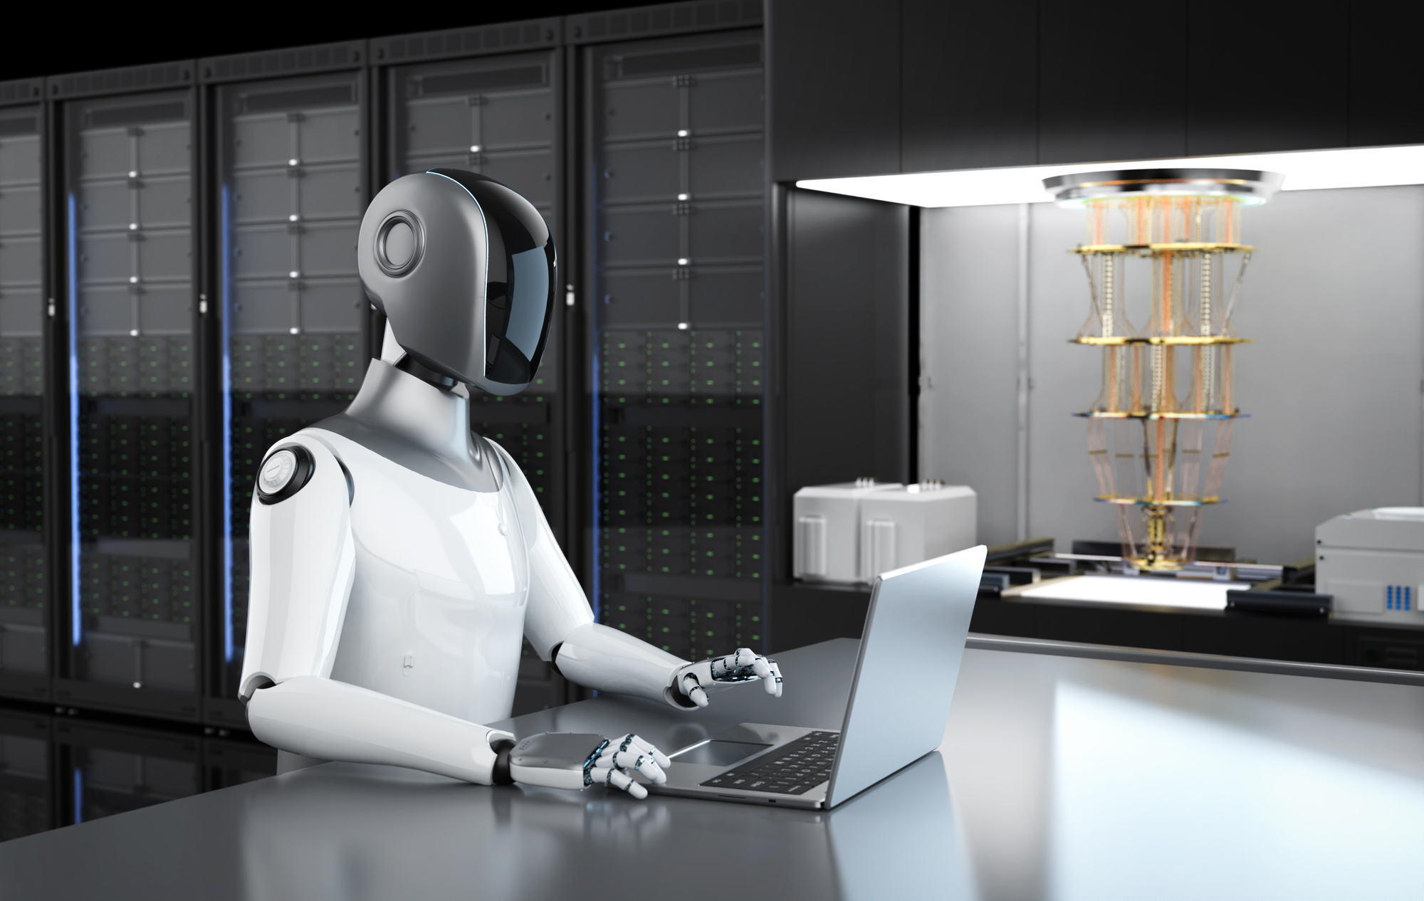
AI in Healthcare
Revolutionizing Health and Wellness
Virtual health assistants
Robotic surgery assistants
Patient monitoring agents

Slide 7
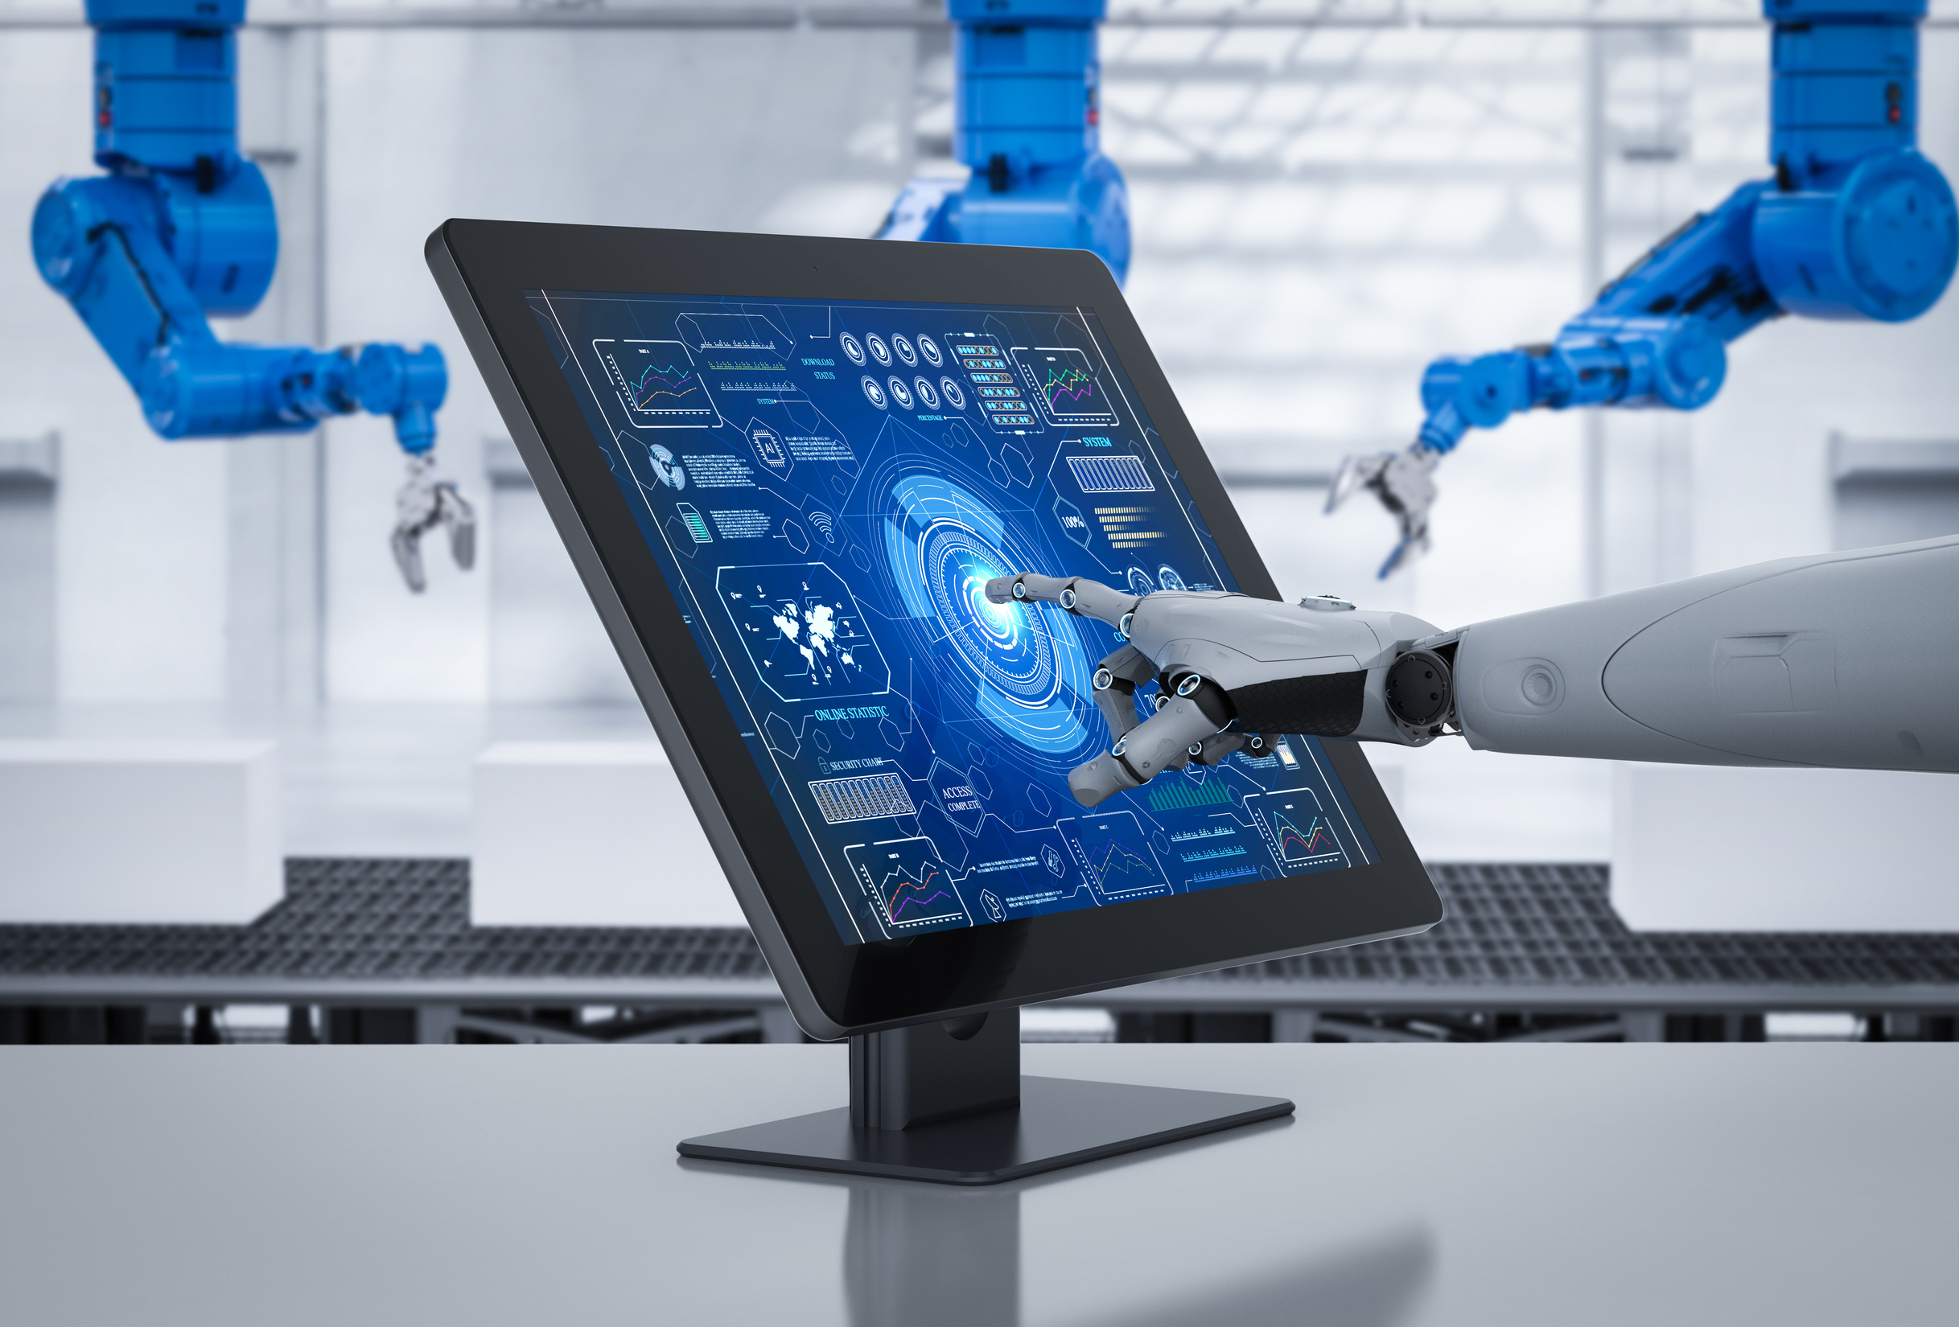
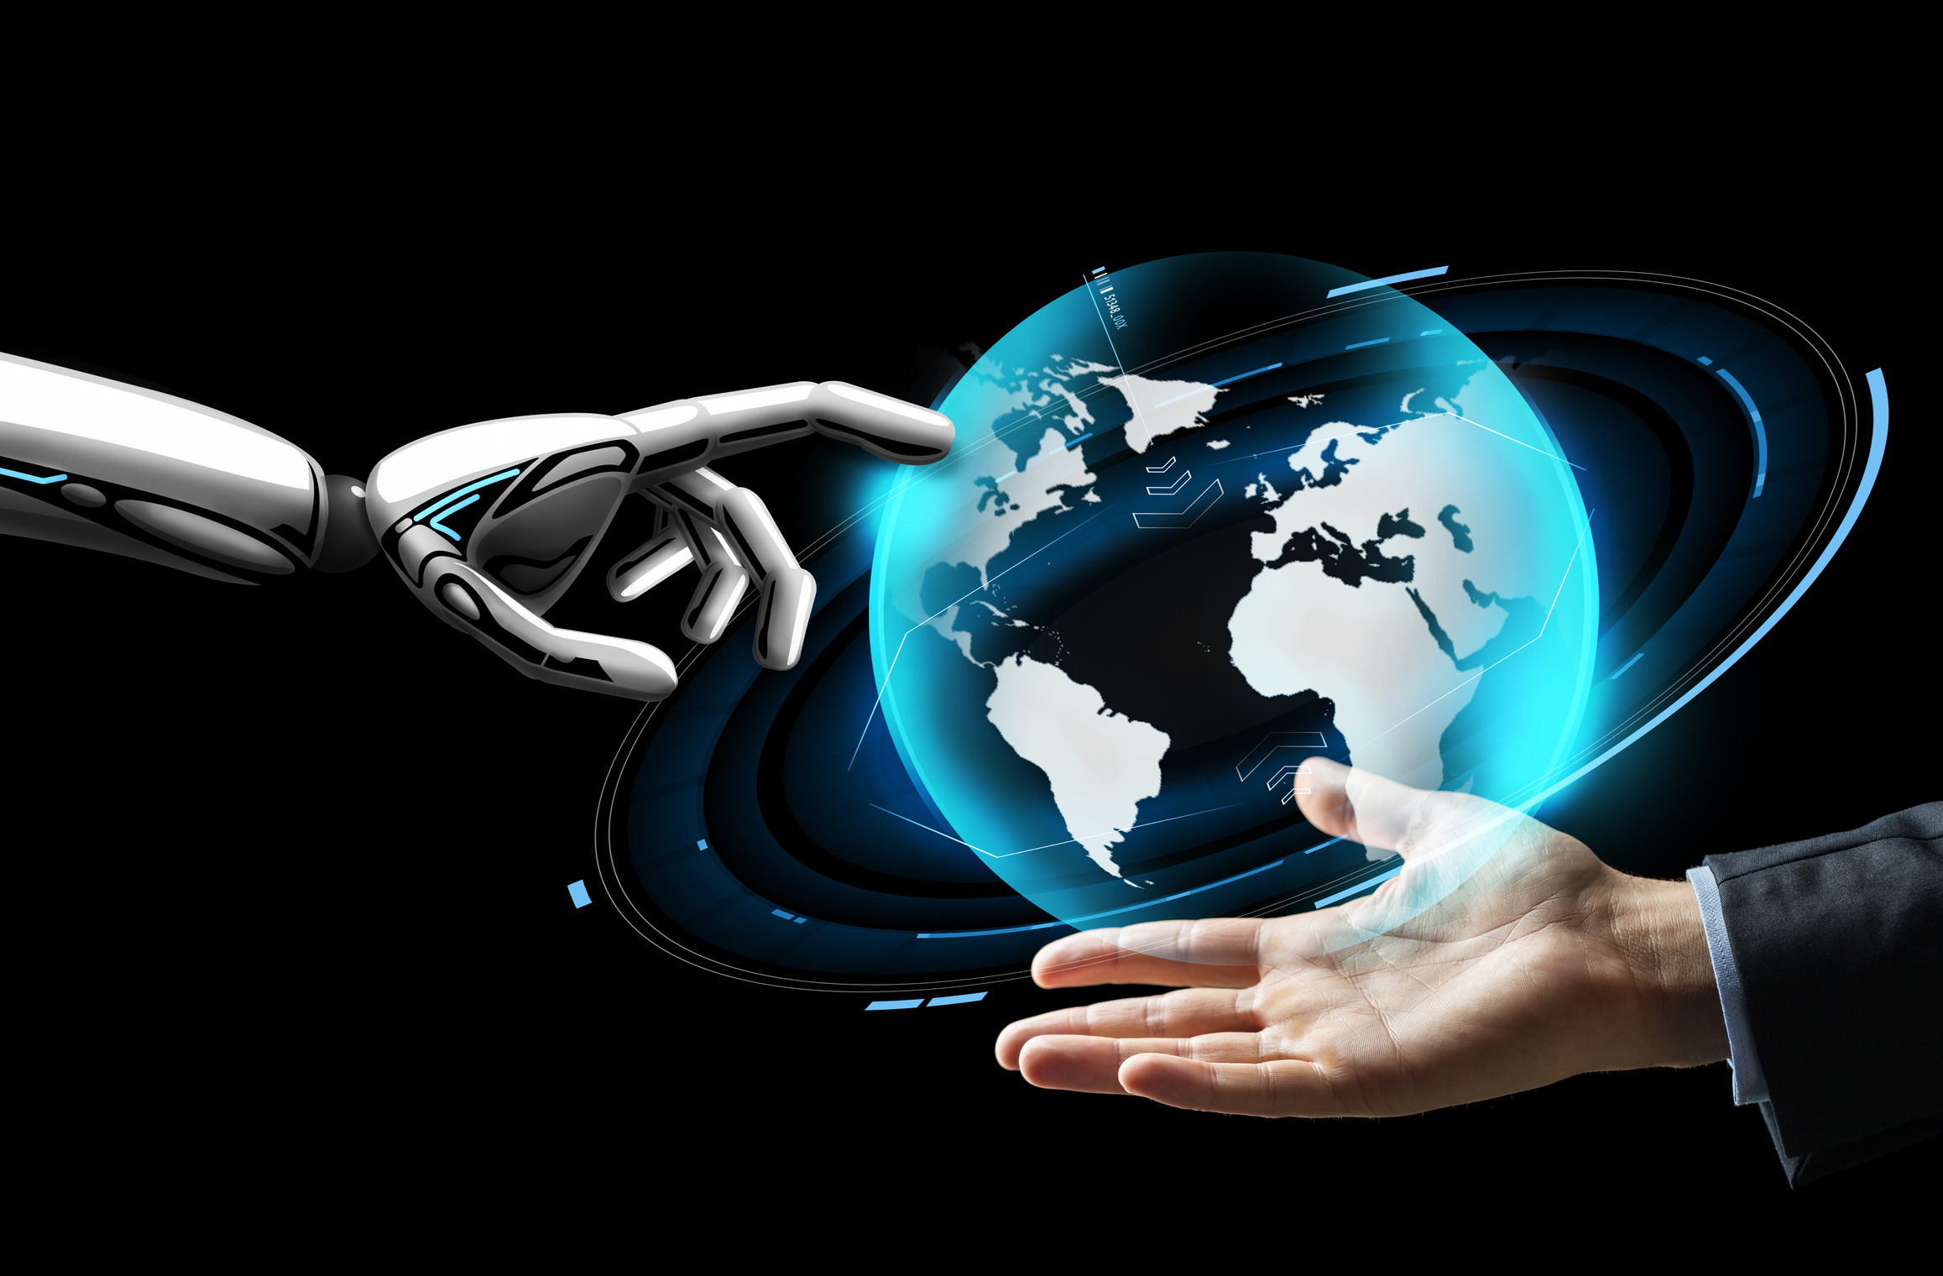
AI in Finance
Fraud detection agents
Robo-advisors
Customer support agents

Slide 8
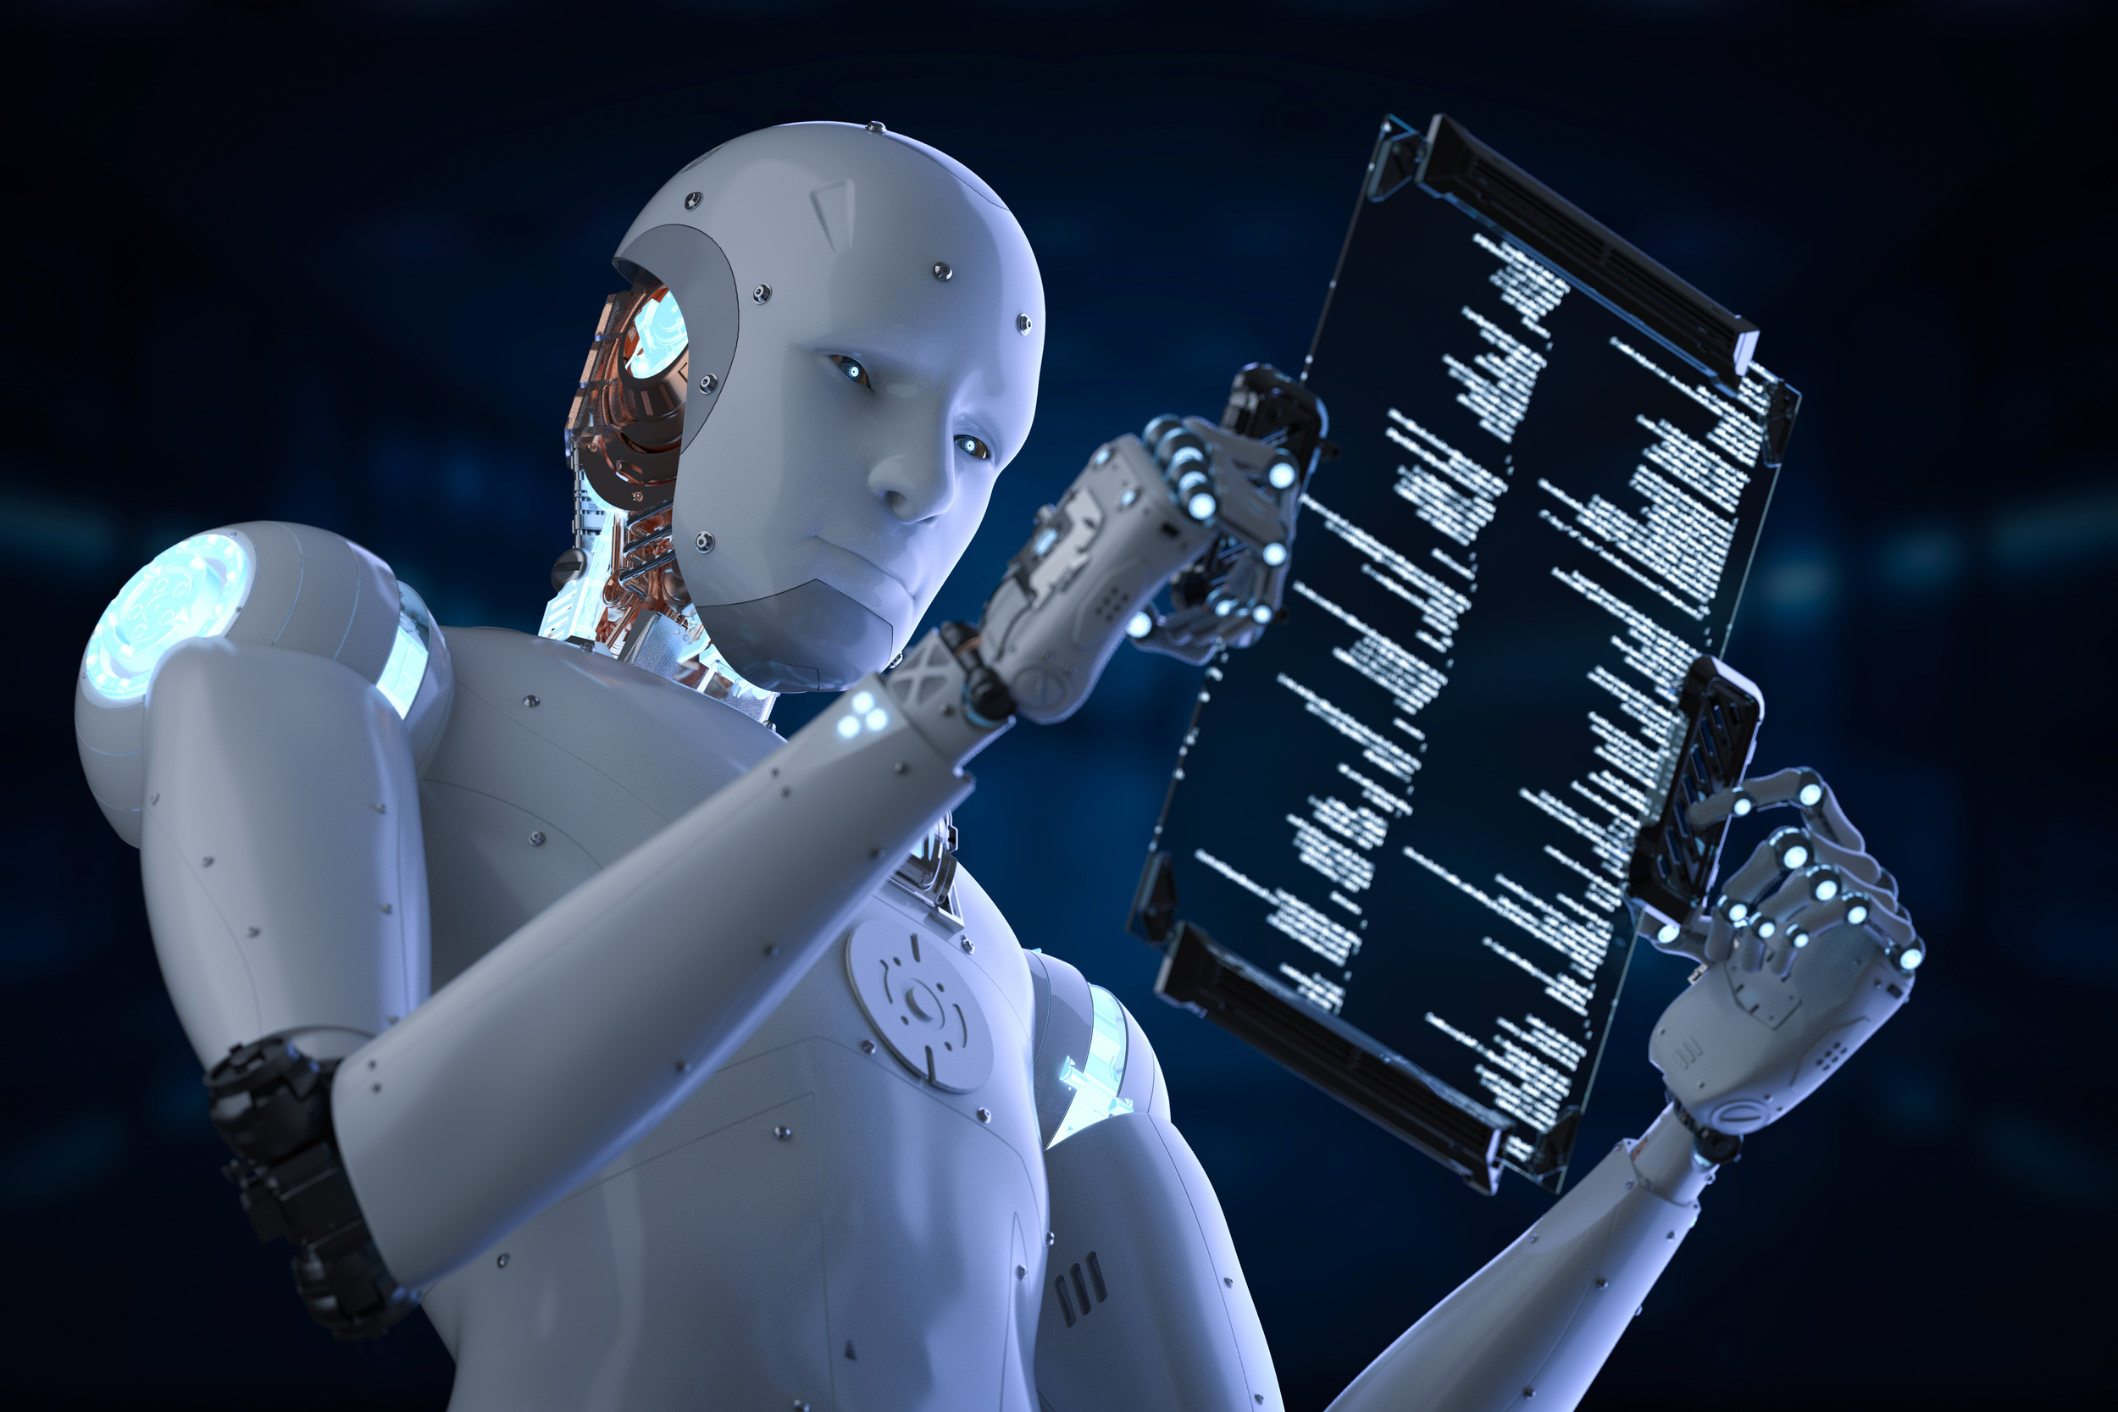
AI in Customer Service
AI chatbots
Voice agents
Sentiment analysis agents

Slide 9
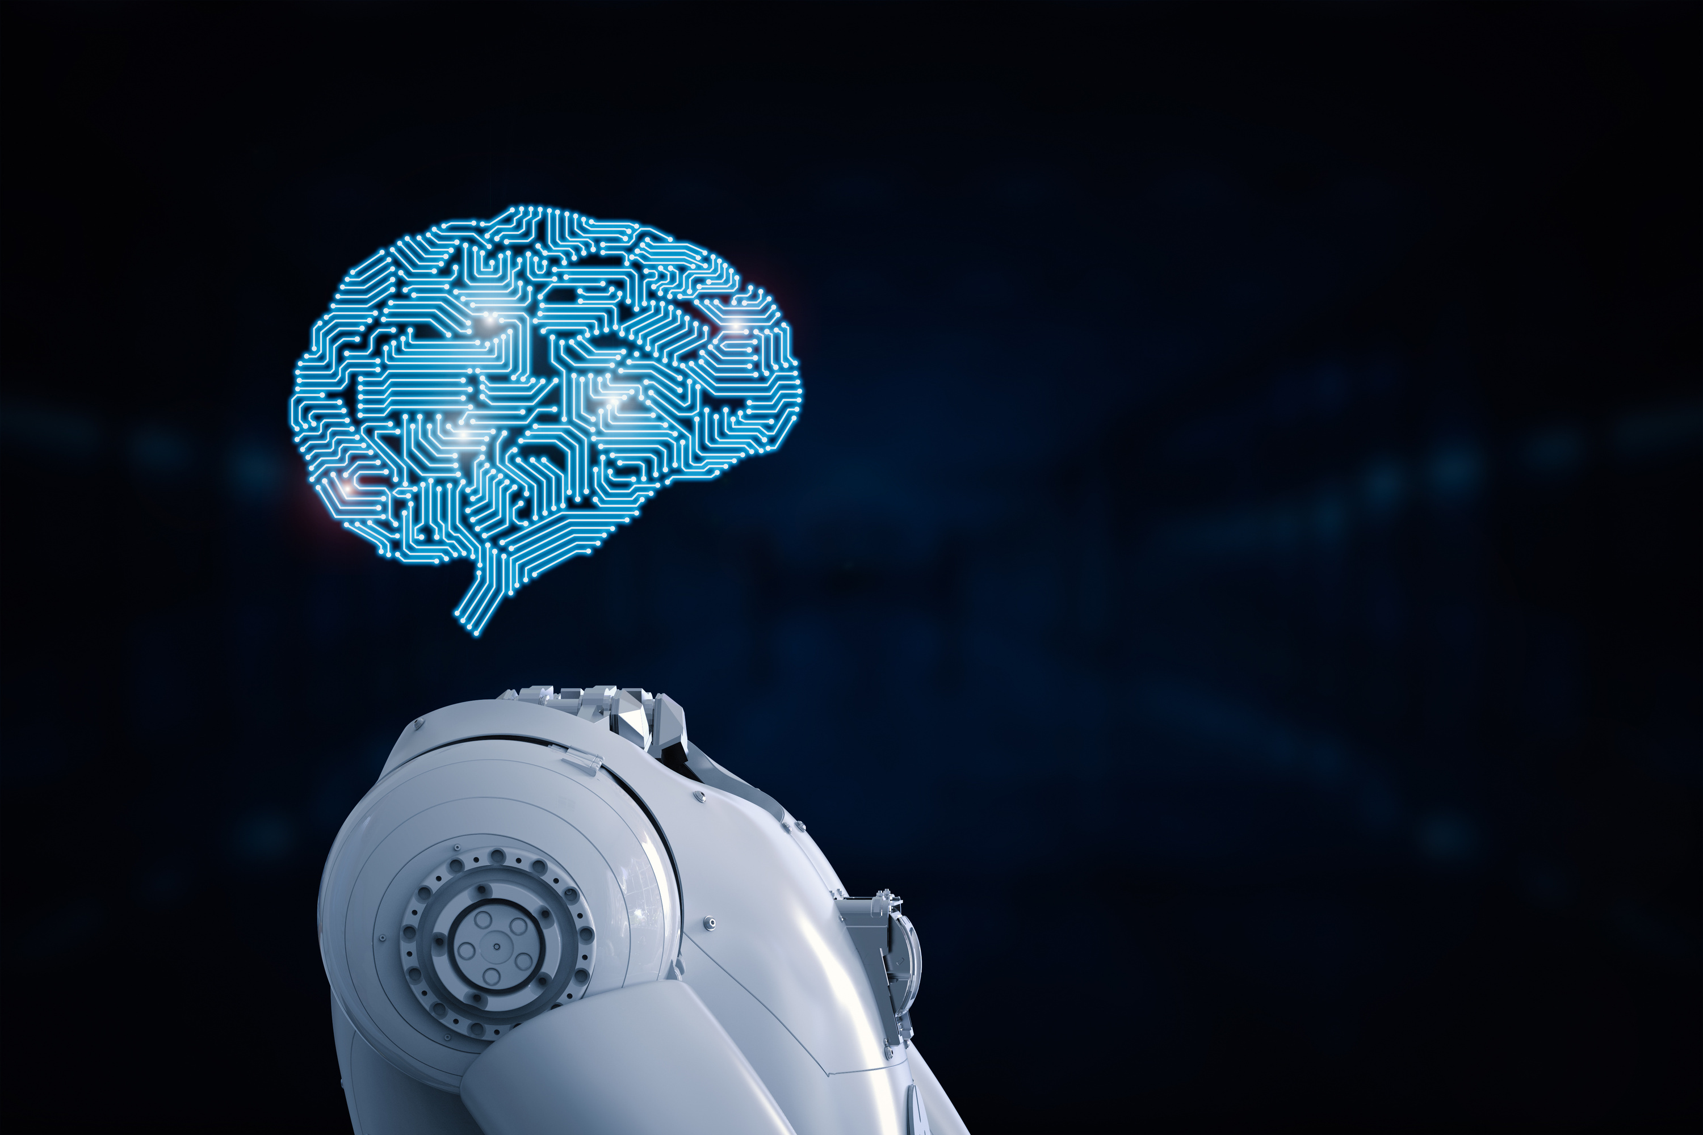
Thank You
Presented By
Nayana ck

